Slide 1
Junior Infant Information Meeting
June 2023

Slide 2
Welcome
Welcome to all parents and guardians.
Your child is embarking on their exciting journey of formal education.
This presentation is here to inform you about what your child will learn in school, what kind of homework to expect, and practical advice to help you support your child as best as you can through their first year of school.
You can access lots of information about the best way to help your child in Primary School on https://ncca.ie/en/primary/resources-for-parents/
The school uses Aladdin Connect to communicate with parents/guardians. You will receive a text message or an email message inviting you to register for this app. This is very important as you will receive information on school events, messages from the class teacher or the Principal, give permissions and pay bills using this app.

Slide 3
Settling In
School opens at 8:45 and finishes at 1:25. For the first week and a half the children will finish school at 12:00 – This will allow them to adjust to their new school after the school holidays.
Please ensure your child is in school on time. It is very unsettling for young children if they are constantly late. This time at the beginning of the school day allows the child to play, chat with new friends, organise their belongings etc.
Please collect your child promptly at home-time. Children become upset if the person they are expecting to be there has not arrived. If someone other than the parent/guardian is collecting your child, please let the class teacher know by texting the school phone or putting a message on the Aladdin Noticeboard.

Slide 4
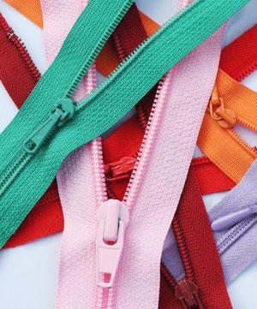
Life Skills
In school children must be able to:
Interact in a safe manner with other children
Take off and put on coat, hat, scarves, jumper, gloves etc.
Open and close buttons and zips
Tie shoes independently (Velcro is a great option in Junior Infants)
Open and close their own school bag and lunch box
Use the toilet independently and wash their hands thoroughly
Blow their own noses and dispose of the tissue in the bin
Open and close their own school bag
Be responsible for their own belongings

Slide 5
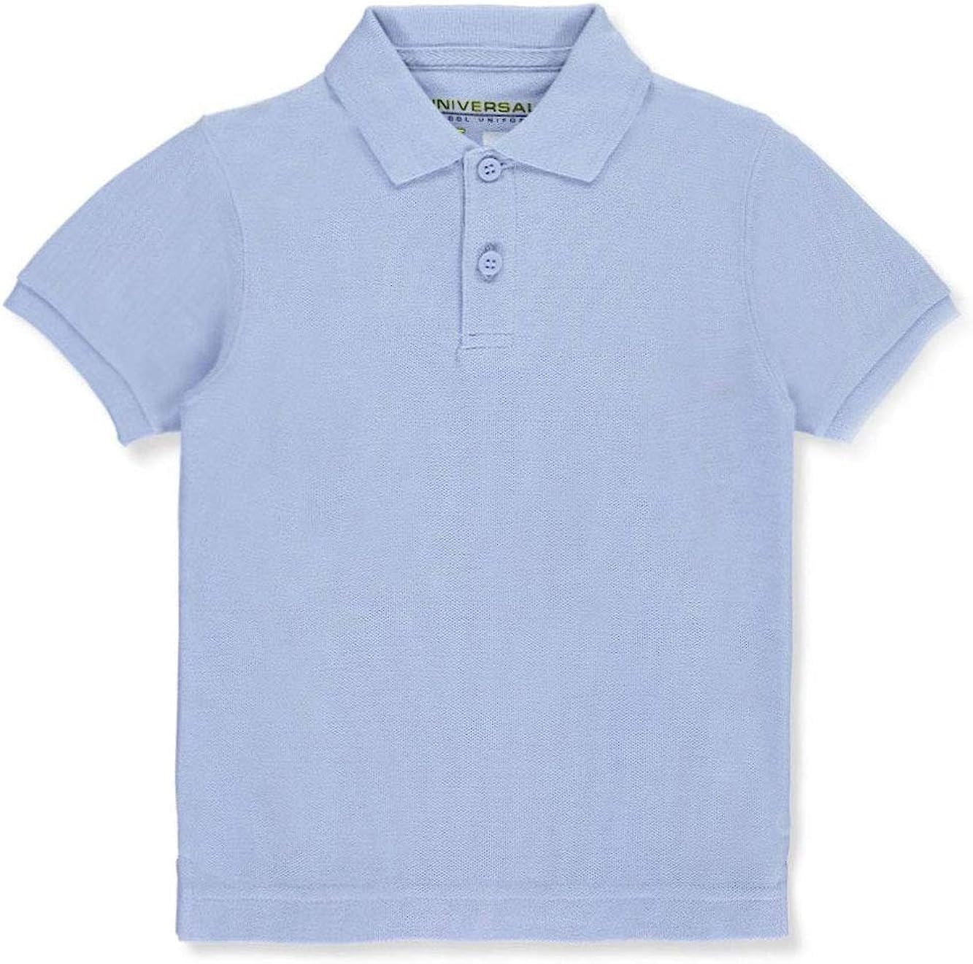
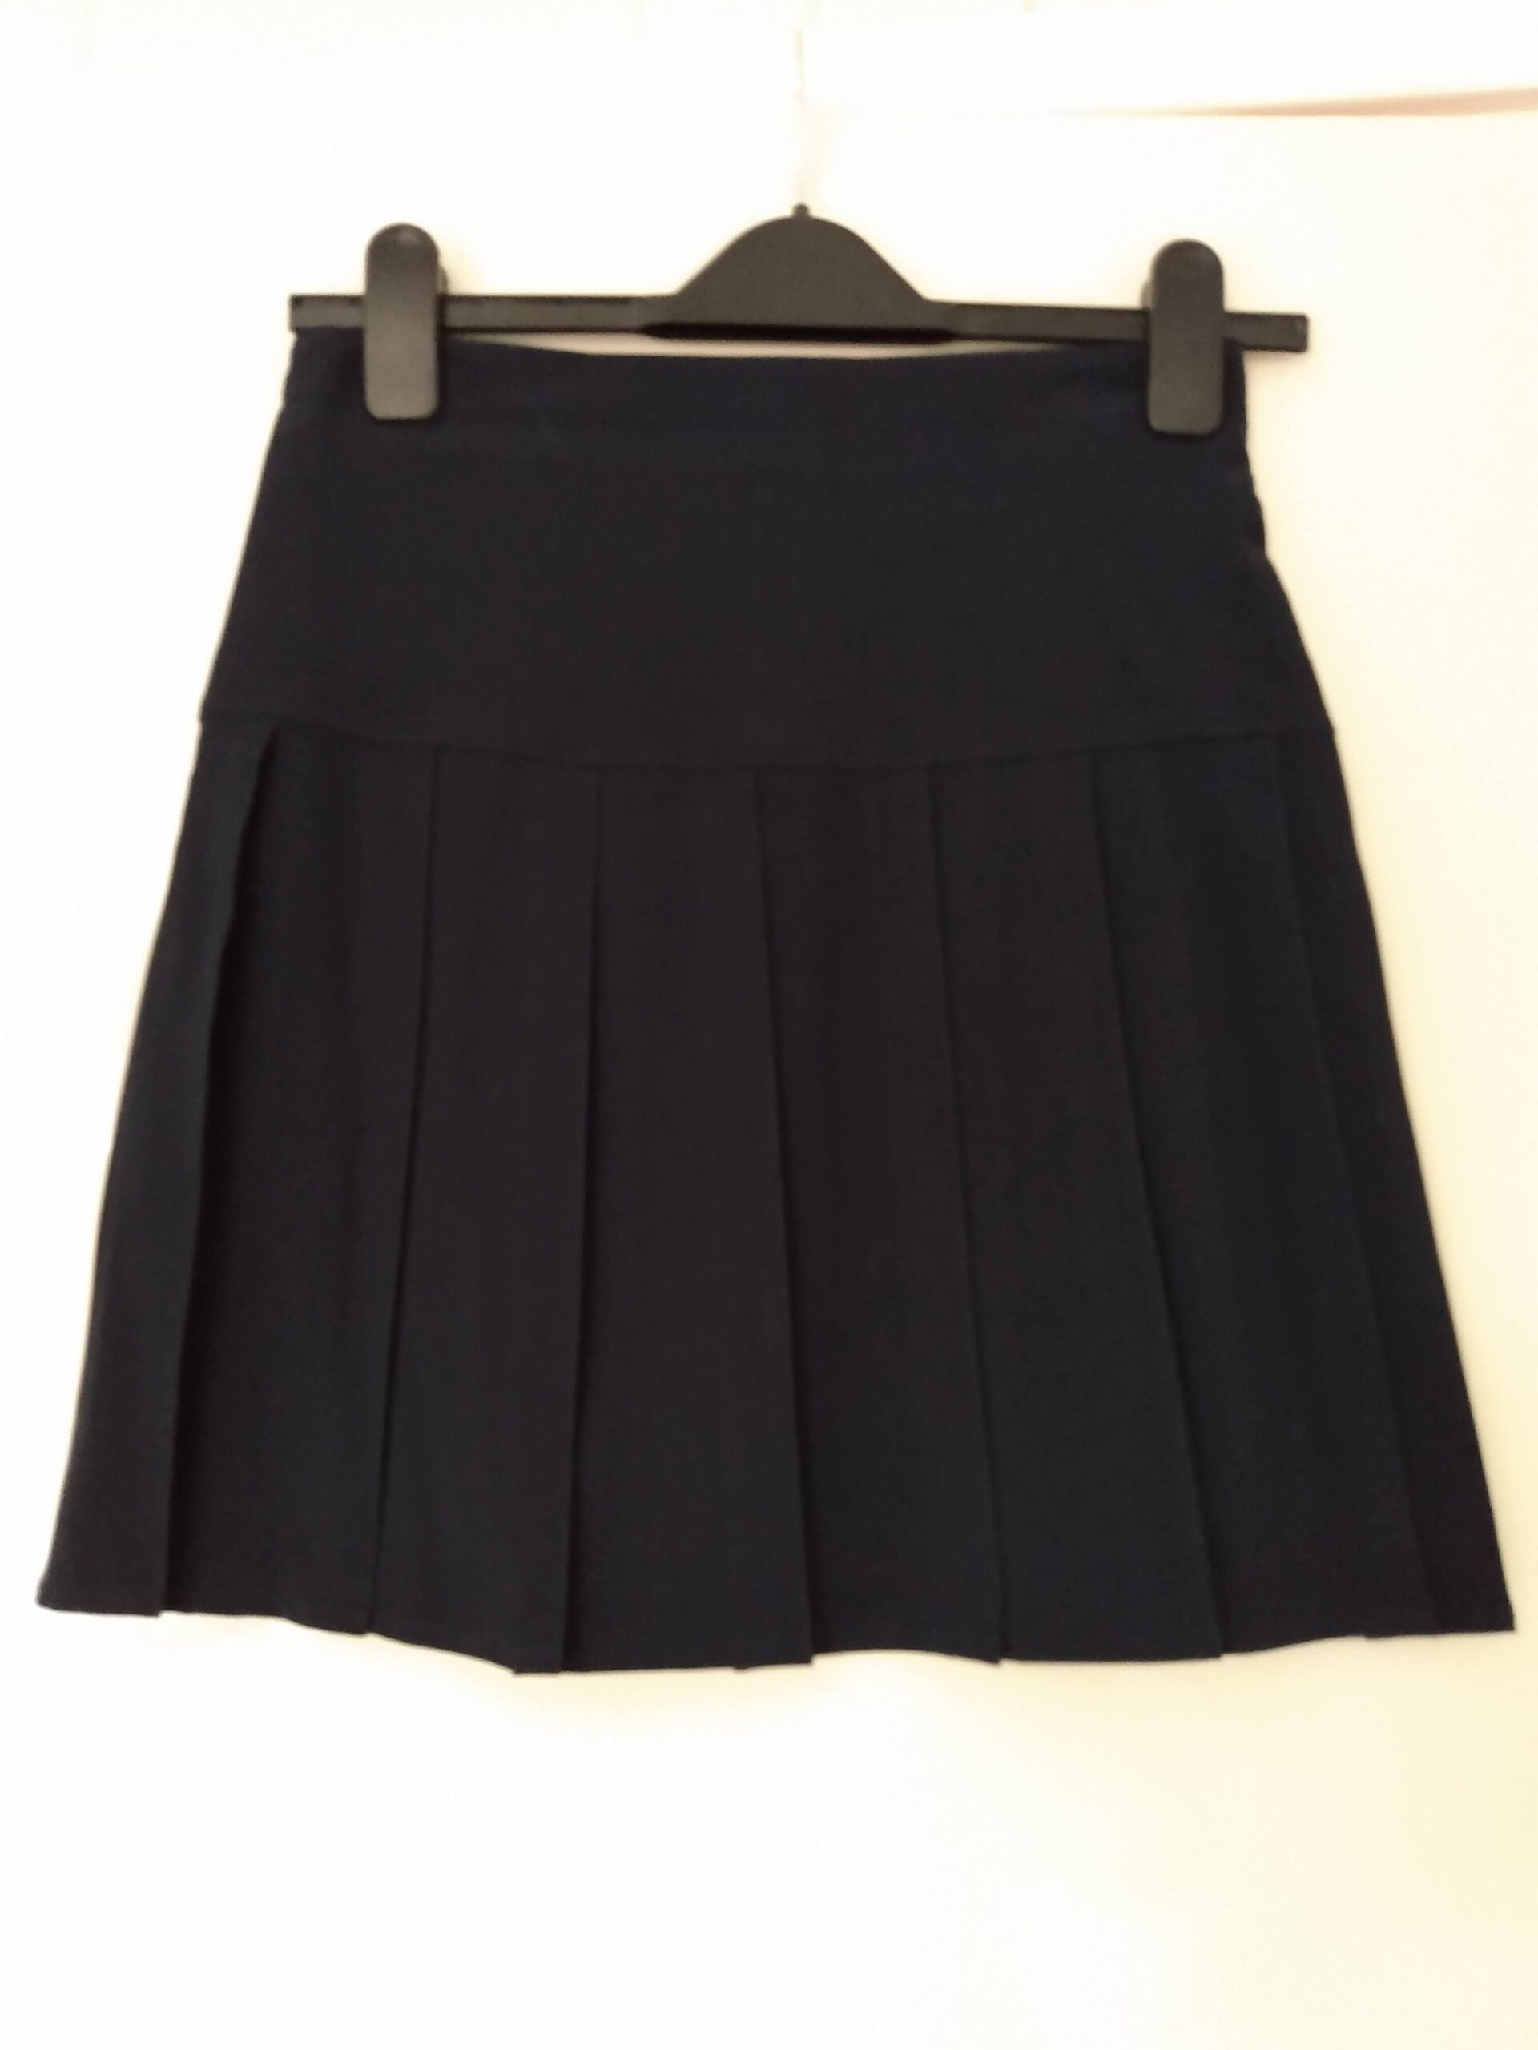
Uniform
In school children must wear:
A light blue polo shirt
A navy jumper, cardigan or sweatshirt
Navy trousers, jeans, skirt, shorts, tracksuit or leggings
Comfortable shoes to run around in
Please label all clothes which can be removed: jumpers, coats, hats etc.
Unless it is raining, children go outside to play during their breaks. Please ensure that your child has suitable clothing to wear outside if it is cold or damp.

Slide 6
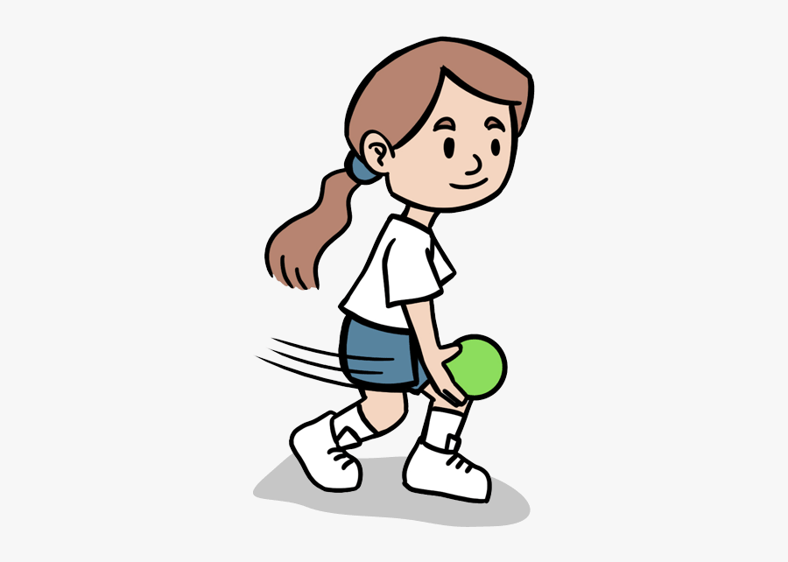
Subject Overview
Junior Infant Curriculum
In Junior Infants, the curriculum areas in the Primary Curriculum Framework are:
Religious Education: we use the Follow-Me programme
Language: English and Irish
STEM Education: Science, Technology, Engineering and Mathematics
Wellbeing: Physical Education, Social, Personal and Health Education
Arts Education: Drama, Art and Music
Social and Environmental Education
This is a new framework which will be introduced throughout the year.

Slide 7
Playful Learning
45 mins- 1 hour per day
Learning through play
Aspects of different curricular areas are integrated into the activities
Oral language and language development
Social skills: sharing, playing and learning together
Based on a theme each month: e.g. home, shop, farm, doctor

Slide 8
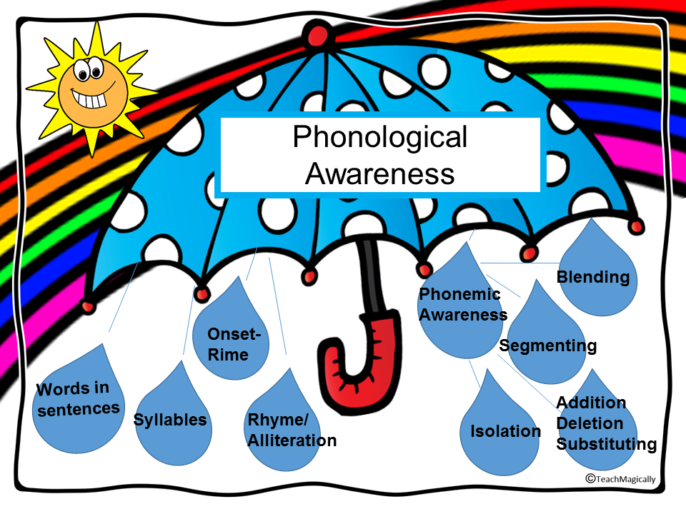
Oral Language – Phonological Awareness

Slide 9
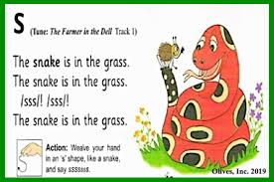
The Benefits of Phonological Awareness
We teach phonological awareness to help pupils with their letter sounds - providing decoding strategies to break words down into the 44 sounds. This supports reading and spelling as the children progress through school
Research shows that using phonics, when taught correctly, is one of the most effective ways of teaching children to learn to read. Sounds are taught from easiest to hardest: single letter sounds first, then moving on to two letters making a sound and so on.
In Junior Infants we concentrate on learning the 26 individual letter sounds using a range of materials and methodologies.

Slide 10
Writing
Pre-writing – Pencil Grip
Writing Milestones
Writing Genres
Letter formation
Writing Sentences
Writing Words
Writing Letters
Mark Making
Drawing

Slide 11
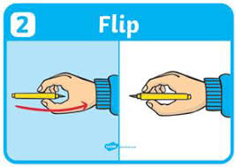
Method used in classroom

Slide 12
How can you help?
Paper Crumpling: Have your child crumple up sheets of newspaper or scrap paper into the smallest, tightest ball possible. Increase the challenge by only letting them use one hand to crumple the paper.
Tape Races: Get your child to tear off lots of pieces of masking tape and place them down on a flat surface (e.g. a table or the floor). Then have a race to see how many they can peel off in one minute!
Play-Doh and Theraputty Exercises: These games are always popular with kids!
Make a spider or octopus by having your child first roll the putty into a ball, flatten it down, and then pinch out eight legs using their pincer fingers (thumb and index finger)
Make spaghetti by having them pull off small pieces of Play-Doh and roll them into long ‘noodles’
Pegs: Pinching and squeezing clips, pegs, tweezers, or even tongs helps build hand muscle strength.
Have your child use pegs to pick up pom poms and move them into a bucket or sort them into groups by colour or size. Have a race to see who can do it the quickest!

Slide 13
Gaeilge
The Gaeilge curriculum in Junior Infants is Oral based.
Children play language games and sing many songs in Irish.
Children learn and use many helpful phrases throughout the day.
Children and teachers speak Irish naturally during the school day outside of the formal Irish lessons.
We use the Abair Liom programme.

Slide 14
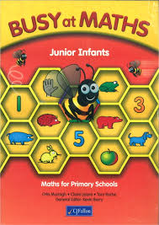
Maths
In Junior Infants, the children will learn to read, write and add with the numbers 0-5.
Other strands on the curriculum include:
Shape and Space
Measures (such as capacity, length and weight)
Patterns
Sorting Objects
Numeracy Games (on interactive whiteboard)
The new maths curriculum framework will be introduced in the next year.

Slide 15
Break Times
Small Break: 10:30 – 10:40
Big Break Lunch: 12:15 – 12:25
Big Break Playtime: 12:25 – 12:45
Wet days: Children stay in the classroom and eat their lunch. Teachers on duty supervise classes. The children can play with some of the classroom toys or will sometimes watch some educational cartoons on the interactive whiteboard.

Slide 16
Healthy Lunches
Suggestions:
fruit
vegetables
sandwiches
cheese
rice cakes
crackers
salads
pasta
yogurt
water
Not permitted:
sweets
crisps
biscuits (except as a treat on Friday)
chocolate (except as a treat on Friday)
chocolate spread (except as a treat on Friday)
fizzy drinks/Capri Sun (avoid fruit juices, if possible)
chips
fast food
cereal bars/breakfast bars

Slide 17
Green Schools
Avoid pre-packaged food, if possible. They are often heavily processed and lack nutritional value.
All packaging is sent home every day. We are a Green School!

Slide 18
Homework
In Junior Infants, homework should only take 10-15 minutes to complete
Activities may include pre-writing activities, oral language activities, phonics and phonological awareness and some maths tasks.

Slide 19
At Home
It has been emphasised to us as teachers at many courses and in service days that
‘Parents are the primary educators in a child’s life.’
Ideas which you could use at home.
Play is a very important part of a child’s development. Please encourage varied play at home. Activities that encourage the use of gross and fine motor skills: running, jumping, hopping, walking, throwing and catching. Lego or other structural activities. Jigsaws, drawing, cutting and sticking.
Stories one of the best things you can do with your child is to read them stories. It does not matter which language you use. Hearing parents/guardians reading, foster a love of reading in children
General behaviour
Encourage thoughtfulness and manners
Teach respect for others and their property
Praise success and reinforce good behaviour
Encourage independence

Slide 20
At home
Language
Talk to your child and encourage eye contact
Repeat words not pronounced correctly so your child can hear it
Talk about pictures in the environment or books. This will increase their vocabulary and develop language
Encourage your child to speak audibly
Help your child to understand it is important to listen to others and to wait their turn to speak
Sing songs or rhymes which encourage language use in a fun way
Encourage your child to carry out simple tasks and instructions
Encourage maths language: positional language e.g. under/ above/ below/ above/ beside etc, shapes, numbers, measures- full/empty, long/short, day/night

